Slide 1

Welcome to CAVC
Cardiff & Vale College
2024 - 2025

Slide 2

Welcome all ESOL Students

Slide 3
Induction
During your induction sessions this week you will:
Learn how to log on to your college email
Learn how to use Teams
Get to know each other
Sign your learner agreement
Complete your learner profile
Know where to get support for learning
Be given your timetable, exam dates, important information
Learn about the importance of safeguarding, respect and wellbeing
Learn how to use the CAVC App

Slide 4


Icebreaker & Introductions
Tell me three things:
Your name
One thing you like
One thing you don’t like
True or false
Two true statements and one false – students have to guess which is which.
OR

Slide 5


English only please:
Practise your English skills
Respect others’ learning
Include everyone
1 Canal Parade
Dumballs Road Cardiff CF10 5BF
Tel: 02920 250 250
ESOL: 02920 250 263

Slide 6
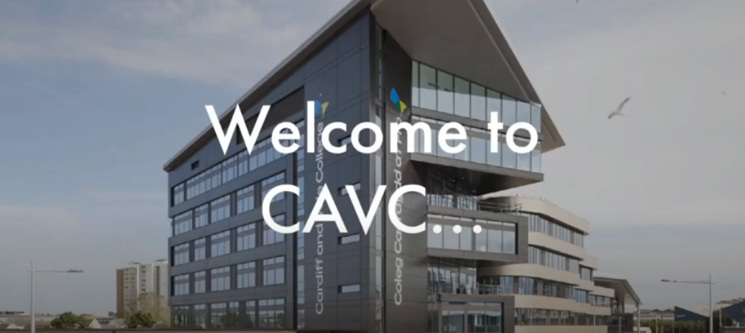
Welcome to CAVC
Welcome message – Sharon James

Slide 7


Learn how to log onto your College Email
Log in to Office 365

Slide 8

Learn how to log on and use Teams
Accessing and Using Teams
Logging onto Teams for the first time Video
Immersive Reader

Slide 9
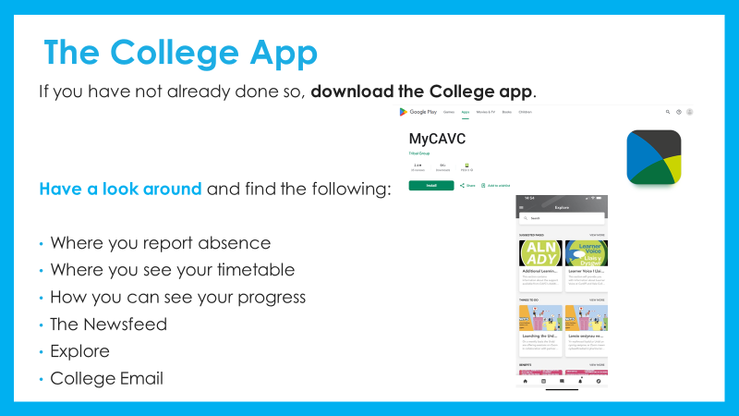

Slide 10
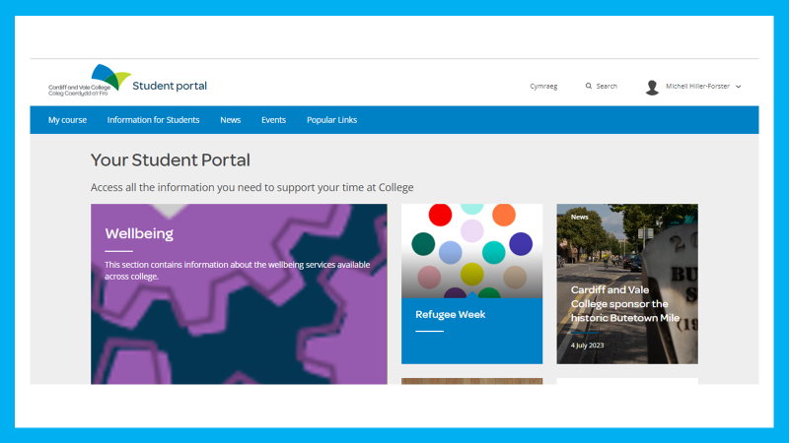

Slide 11


Slide 12

Induction Period
You will complete an initial assessment to check your English level and to give you targets to work towards - your tutor will tell you when you will do this.

Slide 13

Maths assessment for -
All learners in Entry 2 and above
New learners
Learners who have progressed from PT course
Friday 6th September

Slide 14




Blended Learning
You will:
Study face to face
and study online. This is called blended learning.
Sometimes you will meet with your teacher online. This is a live session. Sometimes your teacher may record a lesson for you and you will have to complete it by a set time.
You will also need to complete regular homework.

Slide 15




ESOL 16/17-hours
You will study:
Integrated skills:
speaking
listening
reading
writing
Cultural topical & grammar
Numeracy – E2 and above
.

Slide 16

ESOL 16/17-hours
You will also have:
ILP classes (Independent Learning Plan)
Tutorial sessions
For Entry 3 and Above
ESOL+ - additional area of specialism
Also, for anyone who deals with the Job Centre, this is not a full-time course. It is only 17-hours, which is less than the official number for “full-time” study.
If you were mistakenly to tell the Job Centre you are on a full-time course, you could lose your benefits immediately.

Slide 17

ESOL 16/17-hours
There will also be:
Personal targets to work towards
Regular progress tests
Final exams - Ascentis
Provisional Dates- these are not definite!
Speaking and listening WC 7th – 10th April 2025
Writing WC 9th – 12th June 2025
Reading WC 16th – 19th June 2025

Slide 18
Icebreaker Choose: Ice-breakers
Speaking activity
Talking about topics that interest you
https://eslgames.com/the-expert-game/
Wordwall
Guess the sound quiz
Vehicle Sounds
Household sounds game
OR

Slide 19

Student ID
You must wear your student ID card and lanyard at all times

Slide 20
Your Weekly Timetable
INSERT YOUR TIMETABLE HERE

Slide 21
Term | Activity | Starts | Ends
Autumn Term 2024 | Induction week | 2nd Sept | 6th Sept
 | Autumn term | 9th Sept | 20th Dec
 | Half-term | 28th Oct | 1st Nov
 | Christmas break- college closed | 23rd Dec | 3rd Jan
Spring Term 2025 | Spring term | 6th Jan | 11th April
 | Half-term | 24th Feb | 28th Feb
 | Easter break | 14th April | 25th April
Summer Term 2025 | Summer term | 28th April | 20th June
 | Half-term | 26th May | 30th May
IMPORTANT
Do not book your holiday until after 20th June 2025.

Slide 22
The first 6 weeks of your course, you will be expected to;
Work hard
Be punctual
Attend all classes
Complete all homework on time
Be responsible for your learning
Take all exams entered
Be respectful to others at all times
You will sign a Form learner agreement, to agree to these.
If your tutor has concerns, he/she will speak to you and your Head of Department.
You need to do as expected to be entered for the exams.

Slide 23


Attendance and Punctuality
You must not be late for class – either online or in the classroom.
If you need to leave early you must tell the teacher at the start of the class.
You should have 90% attendance. If you receive a learner grant, low attendance will affect your payments.
You must have good attendance to be allowed on to the next course.
You should check your attendance regularly.
You need to show evidence for all authorised appointments.

Slide 24


Complete your Learner Agreement
ESOL Learner Agreement

Slide 25

Complete your Learner Profile
Learner Information and TT Templates
(choose template from here)
Computer Skills Questionnaire .docx

Slide 26
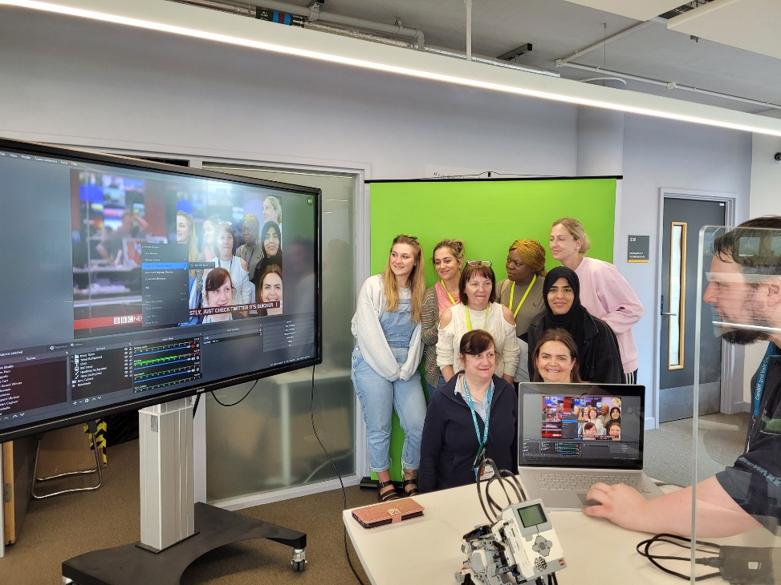
Support for your Learning The Success Centre
The Success Centre and Skills Centre are open every day to support your learning outside class.
The Success Centre is open Monday to Thursday from 8:30 – 5 and on Friday 8:30 – 4.
If you would like extra help with your English/Maths/IT
ask your tutor and he/she will arrange it for you.
You can go to the Skills Centre without an
appointment and somebody may be able to see
You.
You can also contact learningcoach@cavc.ac.uk

Slide 27
There are 365 days in the year.
Of those, only about 168 days in the year are at college.
But, you only come in
for half a day, so… 84 days in the year are in college.
That means you have 281 days a year for family trips, appointments, deliveries, work, and other things.

Slide 28
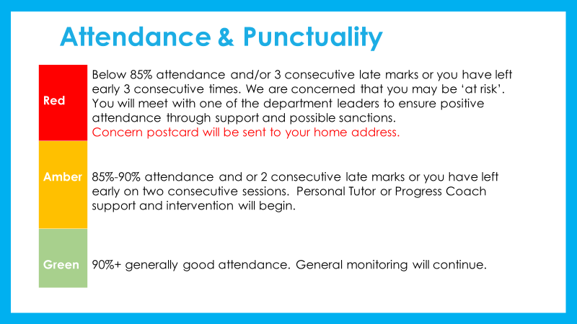

Slide 29
Support for your Learning Your ESOL tutor:
Tutor:
Email:
You can also contact me on Teams Chat

Slide 30

Your Tutor does:
Support your learning
Make sure you’re on the right course and level
Talk to other teachers about your attendance and progress
Keep your college records up to date
Agree to authorise absences in advance when appropriate and check evidence
Ask if you have any problems that may affect your learning
Help you with personal problems
Remove you from the course if you do not behave respectfully or meet the Learner Agreement
Enter you for your exams if you meet requirements
Write a letter of recommendation for you at the end of course (upon request when appropriate)
If you need help filling in forms speak to your tutor and he/she will arrange for someone to help you
Your Tutor does not:
Fill in your forms
Make appointments for you
Authorise absences in the distant past

Slide 31
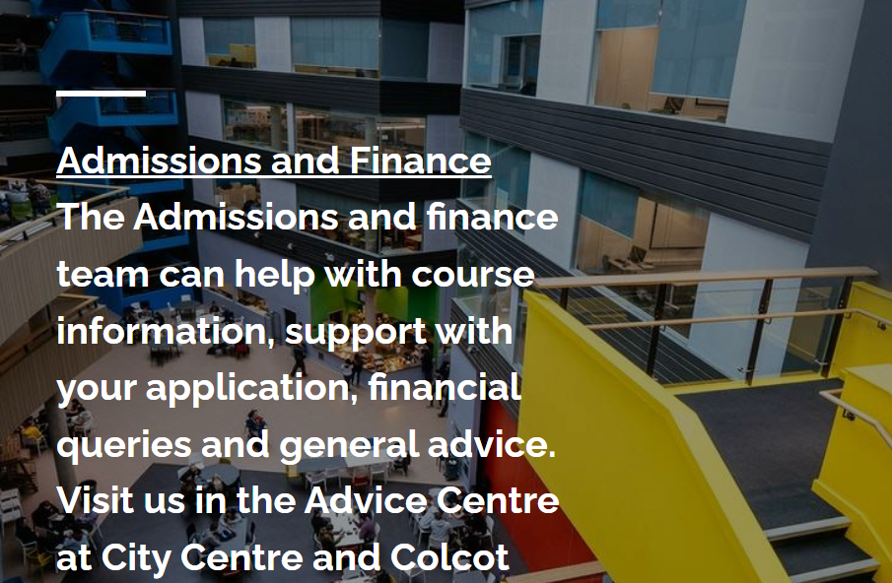
Student services
WGLG/EMA
Bus/Train passes if you live more than 3 miles from college
Help with childcare costs and course equipment

Slide 32
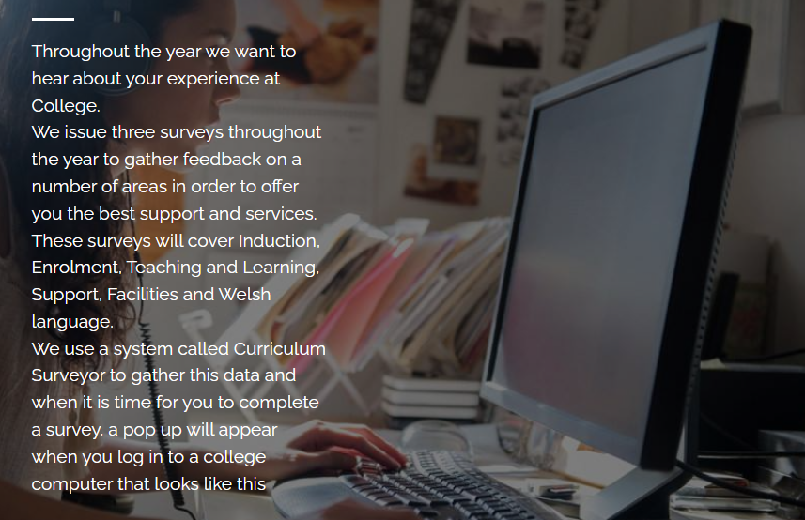
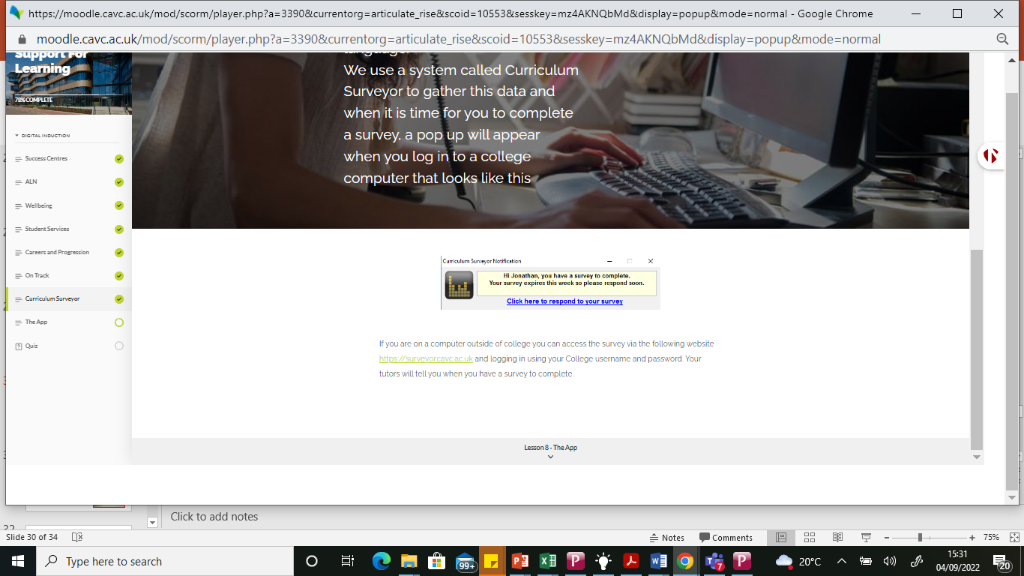
Pulse surveys
3 surveys
Induction and Enrolment
Teaching and Learning Support
Facilities and Welsh Language
We use a system called Curriculum Surveyor. You will see a pop up appear when you log onto a college computer

Slide 33
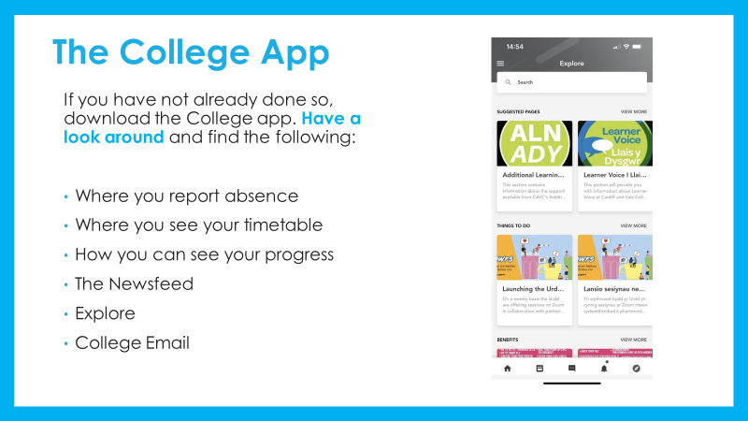

Slide 34

Circle Time Activity(adapt to level)
Deserted Island
You will be trapped on an island for one year and cannot leave.
You can take 5 things with you.
On the island there is: freshwater, monkeys, coconut trees and fish in the surrounding waters.
You must tell the class the 5 things you decided to bring and why.

Slide 35
Be ready to learn
Please make sure you have the following for every lesson:
- Pens (more than one!!)
- Paper
- A folder or file to keep your papers tidy, safe and dry

Slide 36
Reminder: Numeracy assessment
Date: Friday 6th September 2024
Time:
Place: 1 Canal Parade, Room 216-219
Bring a pen.
Please make sure you attend. It is very important.

Slide 37

Any Questions?

